Slide 1
Training Academy Role Based System to Control Access
Raktim Raihan

Slide 2
Technologies
Spring Boot – v2.7.0
React JS – v18.*.*
Bootstrap – v5
Xampp
IntelliJ Community Edition
Visual Studio Code

Slide 3
Overview
There are three users in the System:
Admin – Admin has all the access and can modify and read all the data.
Moderator – Assigned to Trainers. A trainer can view his class schedule and review the quizzes.
User – Assigned to Students. Can submit the assigned assignment and can view his class schedule.
NavBar is modified according to the roles.

Slide 4

Overview
Security
JWT Token Based Authentication
After login token is stored to browser
On log out token is deleted
Front end side, token is sent as header.

Slide 5
Design Pattern Followed
Backend
DTO, Template Pattern – Provided Abstract class to create Entity.
Spring:
Transactional Design Pattern: Controlling few transactions. Trainee Controller
Front Controller Design Pattern: Spring dispatcher servlet handles all the request. Later, for same kind of component sub-set of controller classes are used.

Slide 6
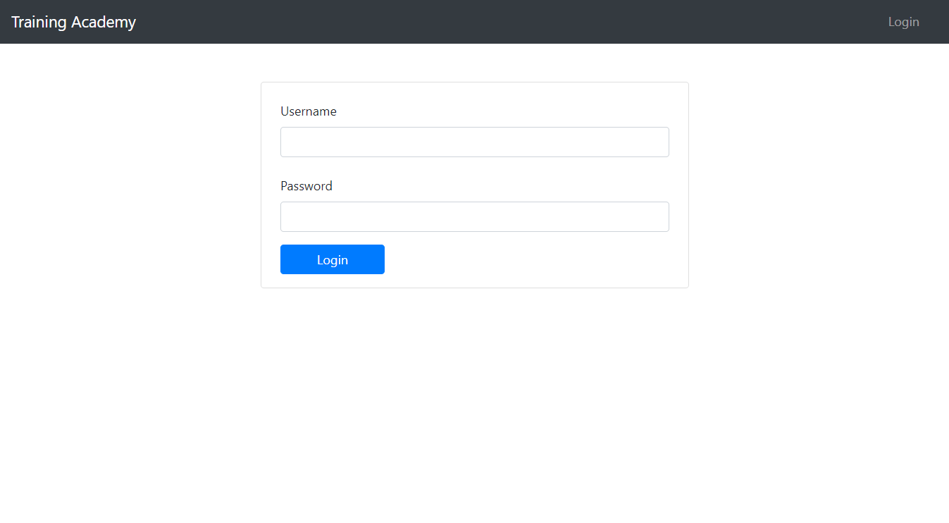
Login

Slide 7
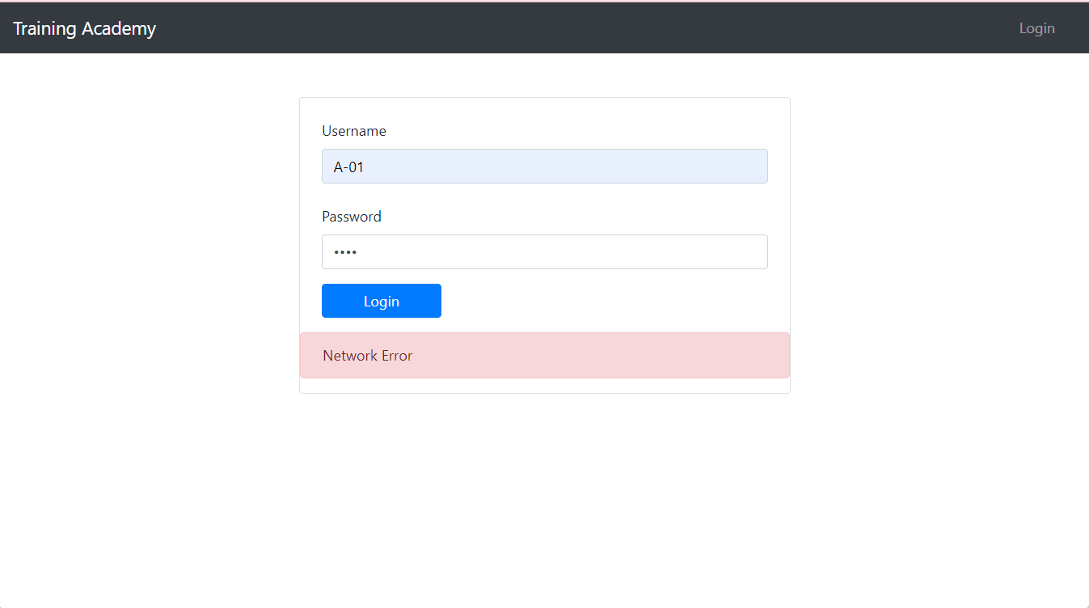
Exception Handling

Slide 8
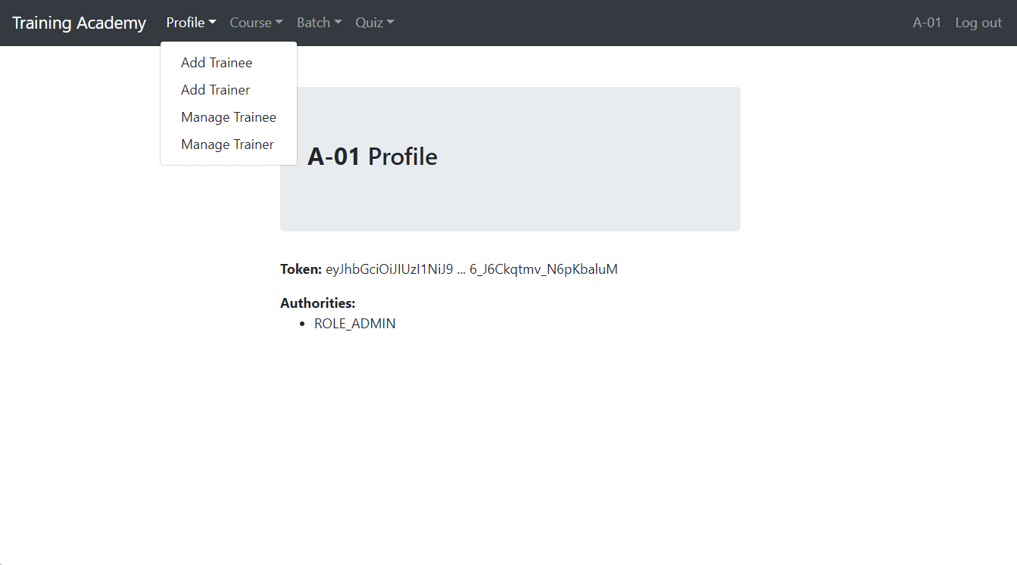
Admin View

Slide 9
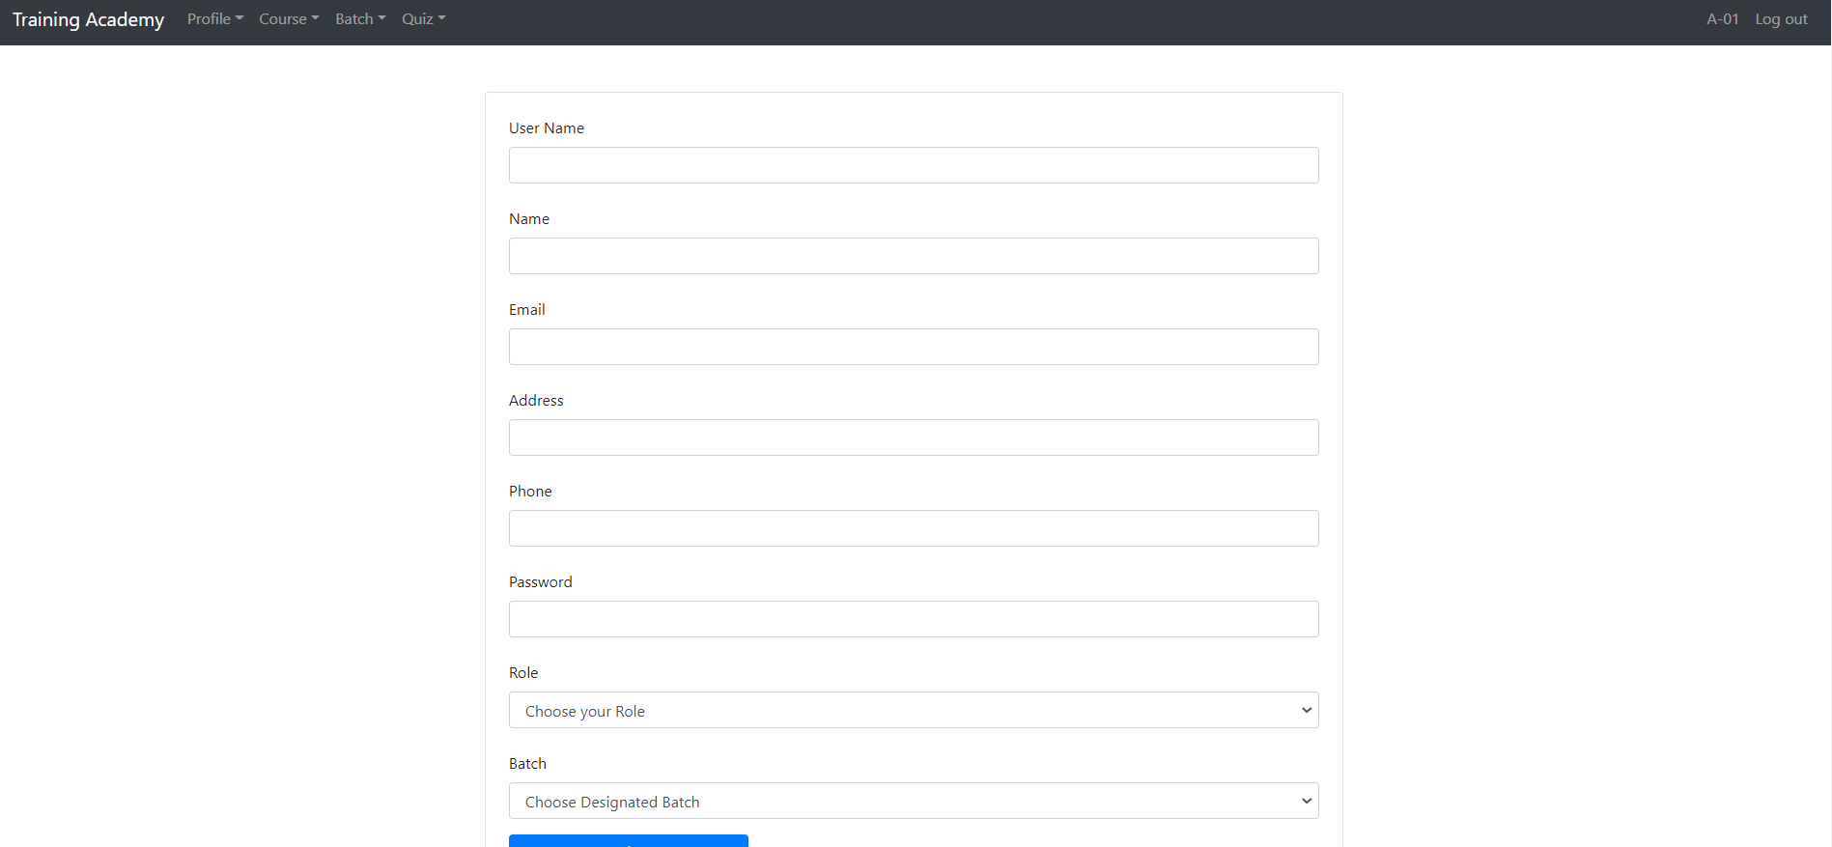
Trainee Registration

Slide 10
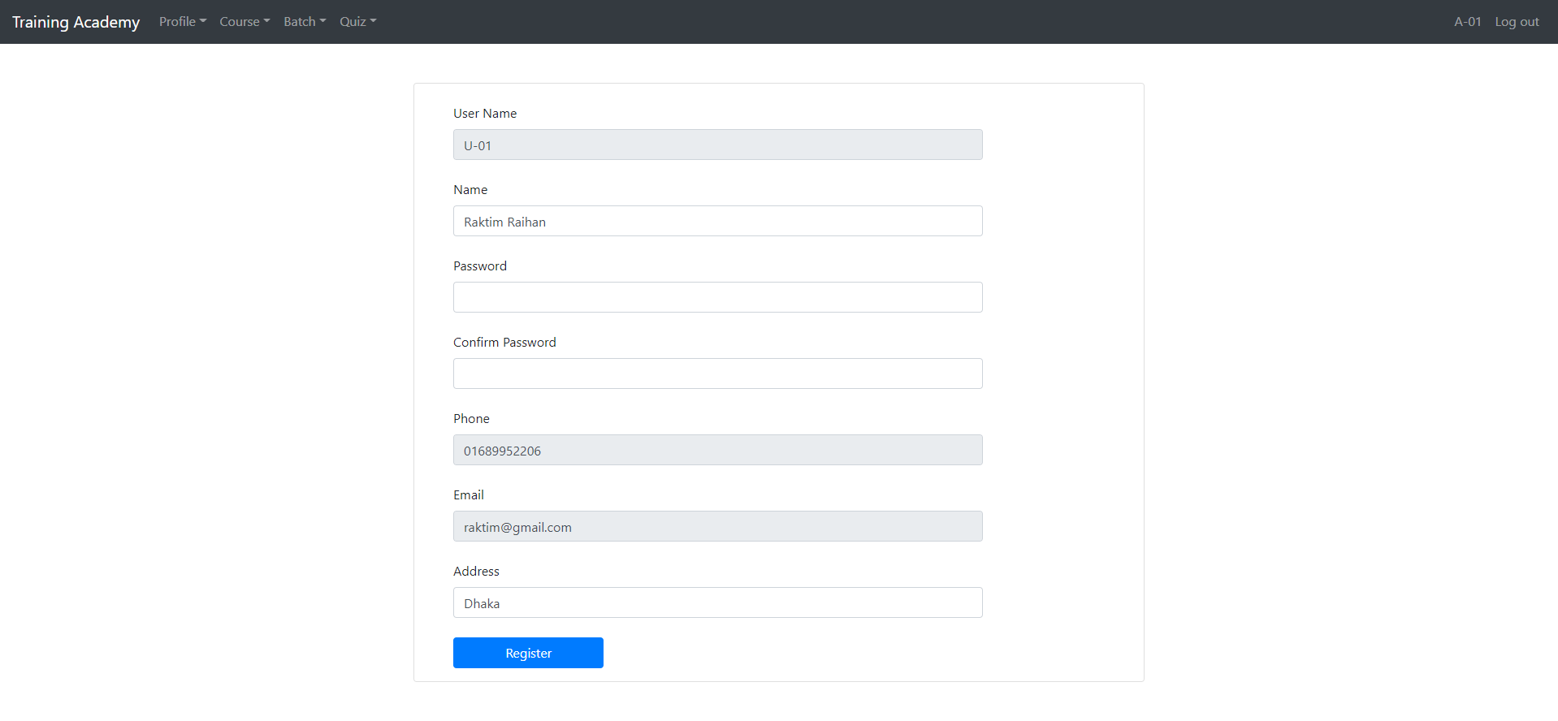
Trainee/Trainer Update

Slide 11
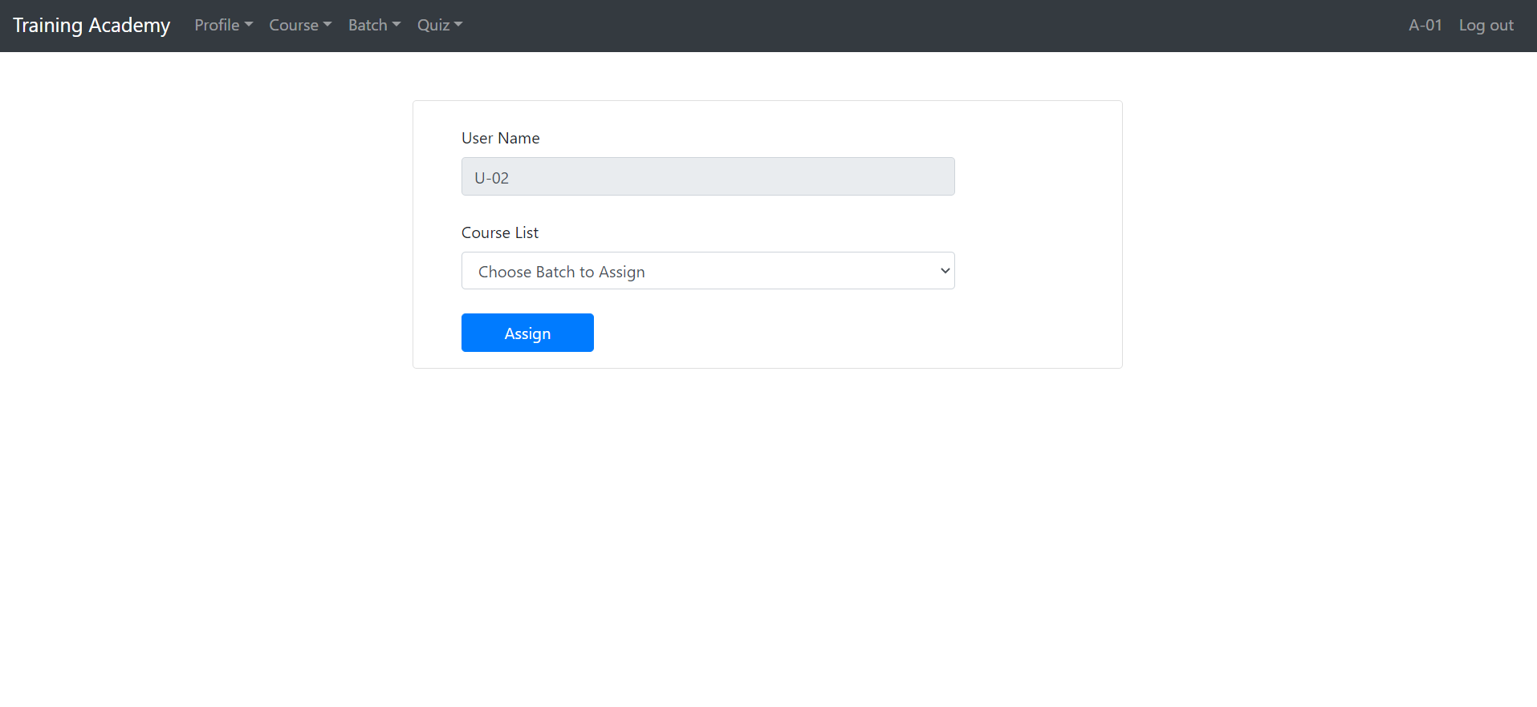
Trainer Course Assign/Trainee Batch Assign

Slide 12
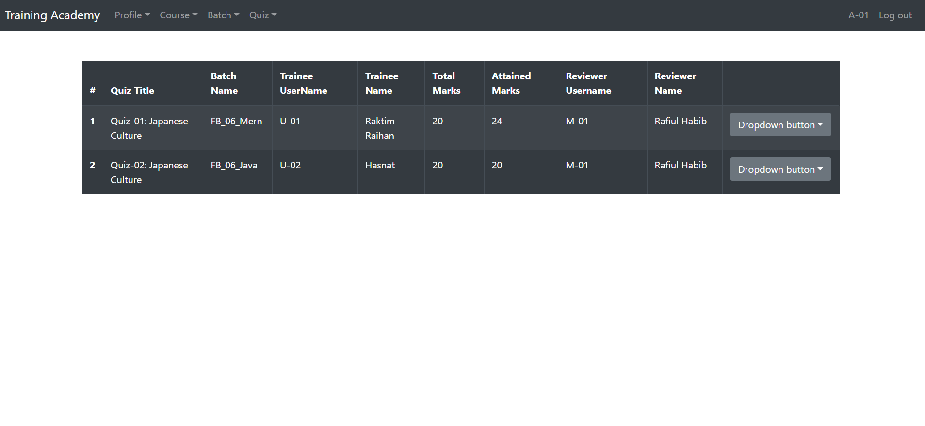
Quiz

Slide 13
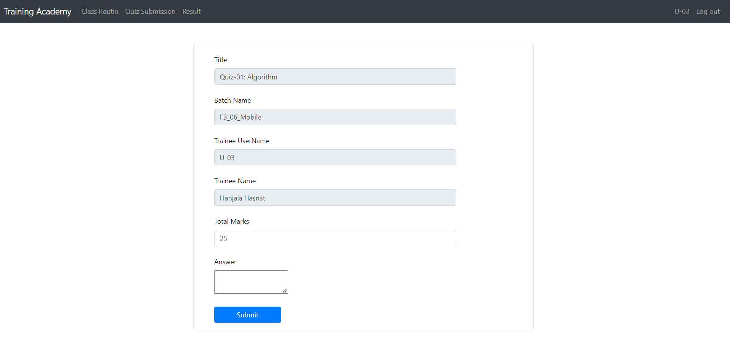
Quiz Response From Trainee

Slide 14
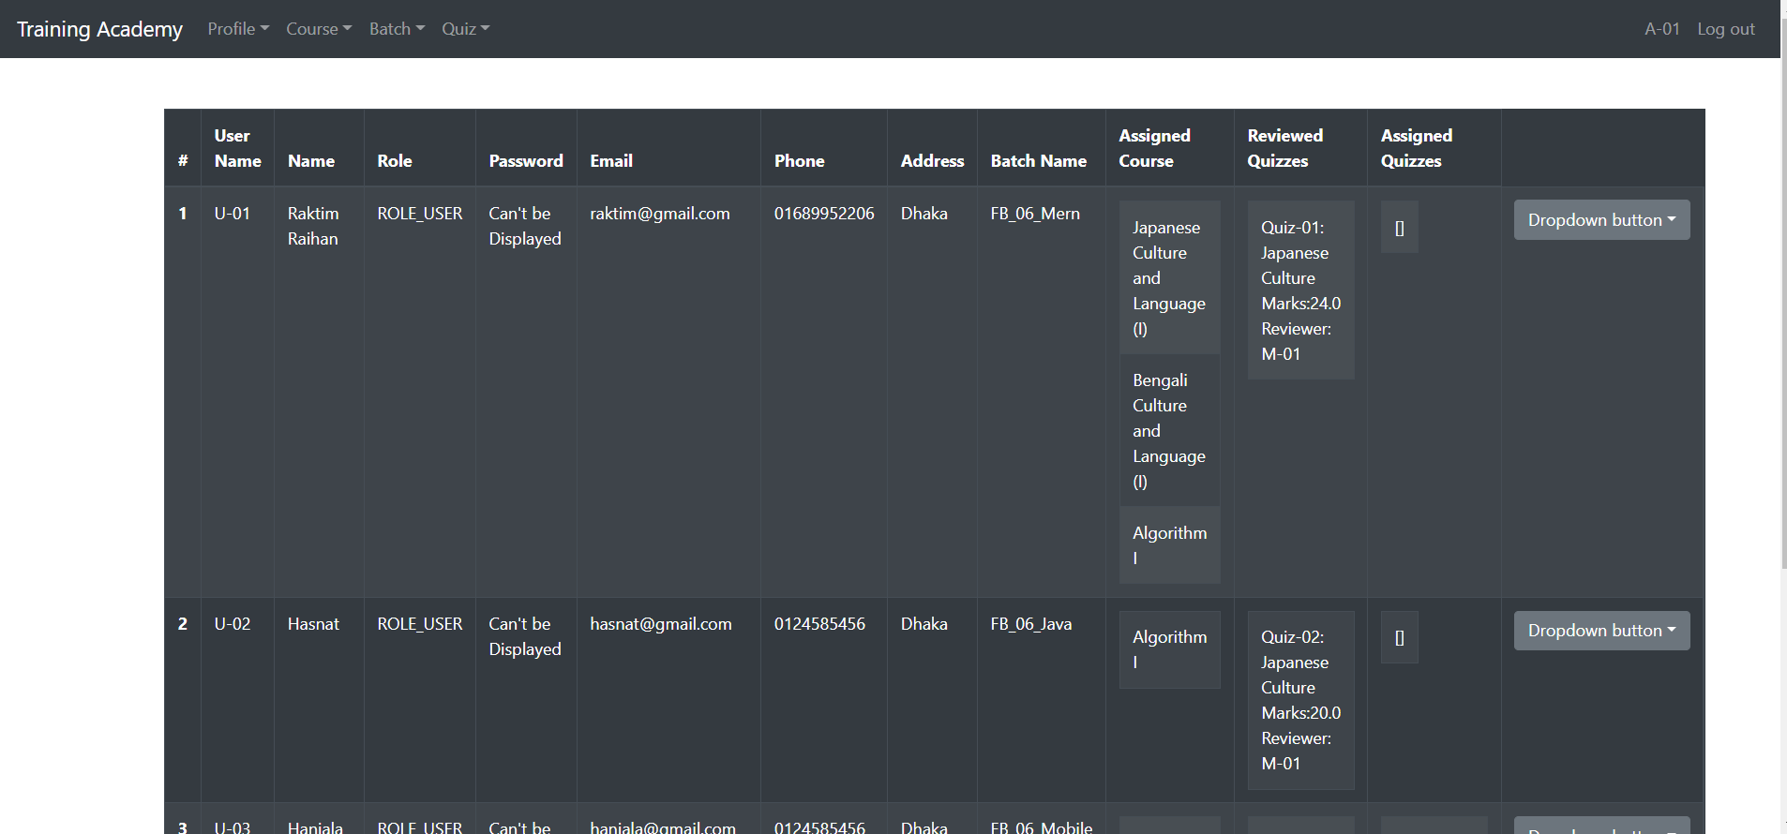
Trainee Manager

Slide 15
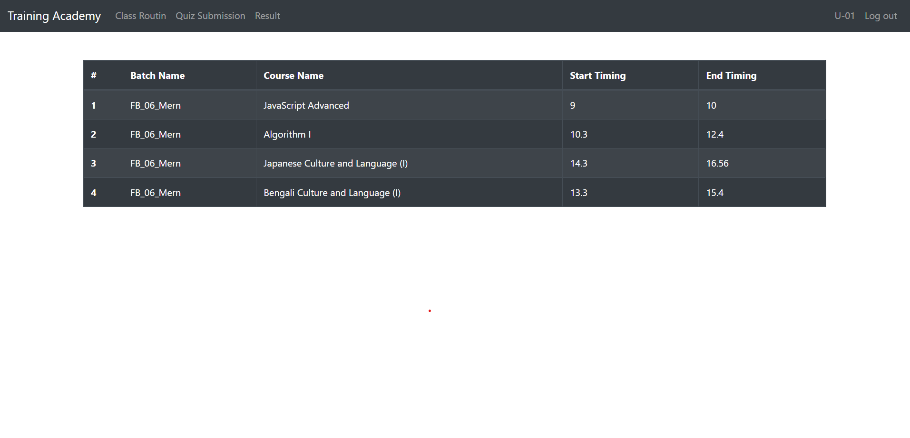
User Navbar

Slide 16
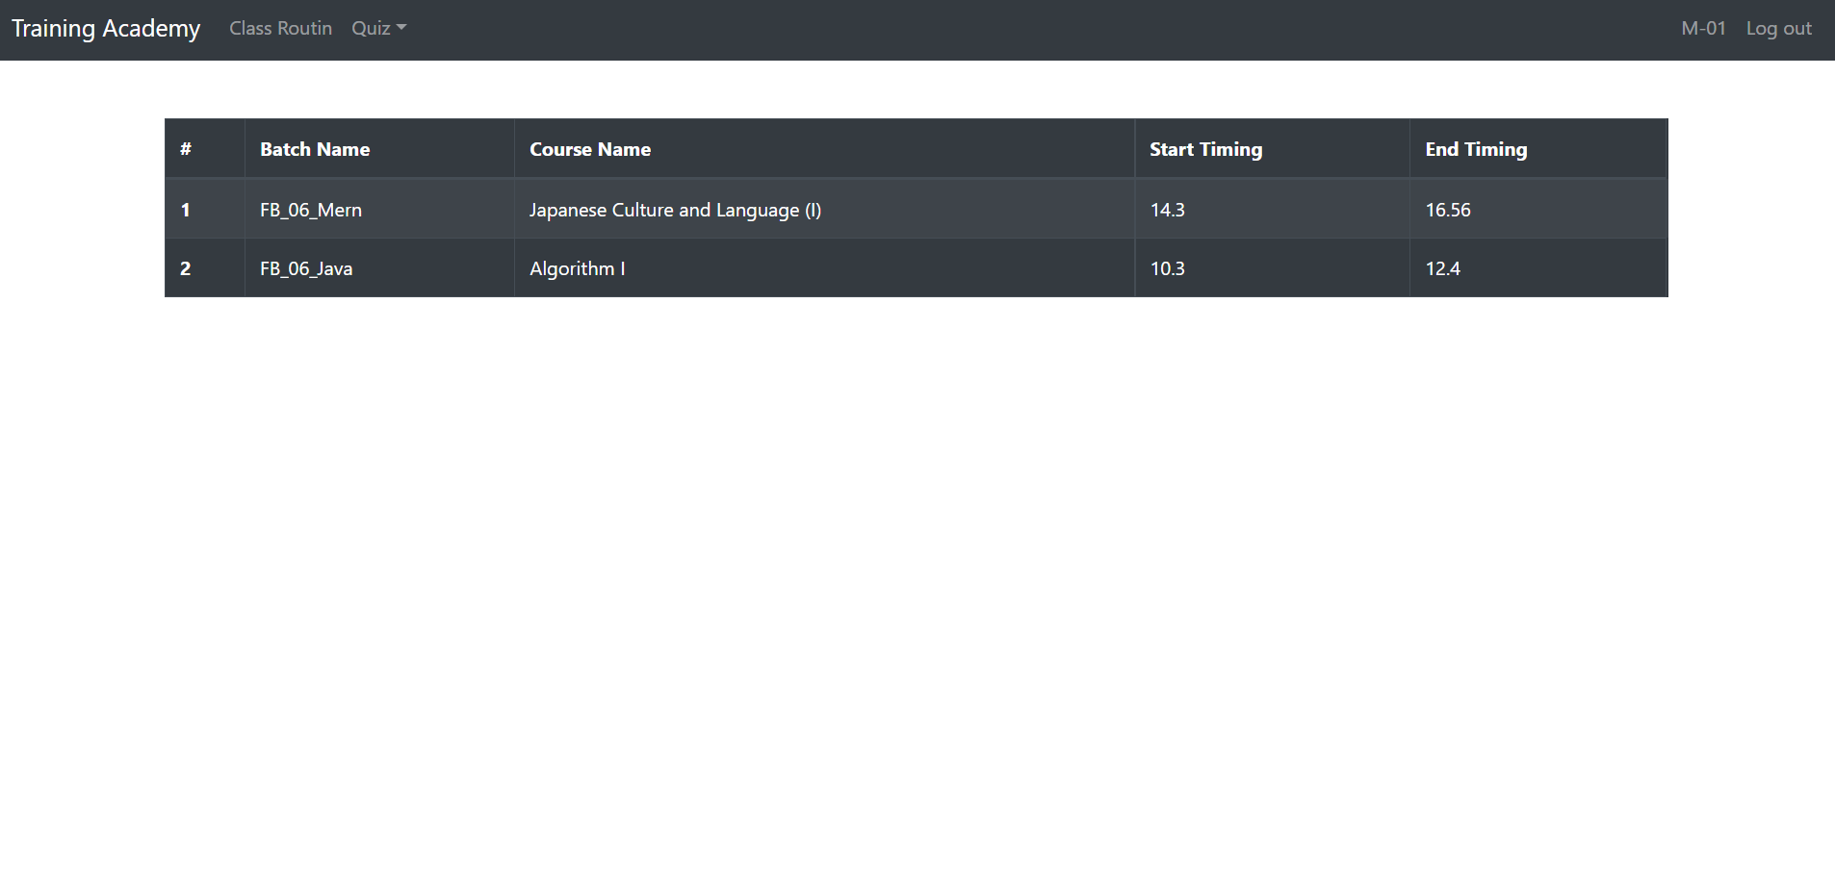
Moderator

